Slide 1
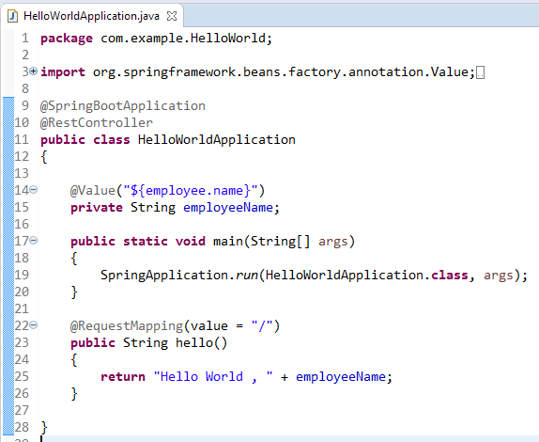

@Value Annotation
The @Value annotation is used to read the environment or application property value in Java code.
@Value("${property_key_name}")
We can set the default value for the property using this syntax

